Slide 1
Polynomial Regression
Abhishikta Varma

Slide 2
Introduction
Polynomial Regression is a regression algorithm that models the relationship between a dependent(y) and independent variable(x) as nth degree polynomial of x.
That is, if your dataset holds the characteristic of being curved when plotted in the graph then you should go with polynomial regression instead of Simple or Multi Linear regression models.
It is also called the special case of Multiple Linear Regression in ML. Because we add some polynomial terms to the Multiple Linear regression equation to convert it into Polynomial Regression.
The dataset used in Polynomial regression for training is of non-linear nature.
It makes use of a linear regression model to fit the complicated and non-linear functions and datasets.
Hence, "In Polynomial regression, the original features are converted into Polynomial features of required degree (2,3,..,n) and then modeled using a linear model."

Slide 3
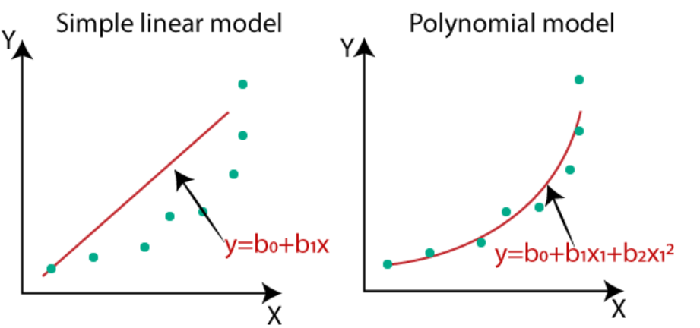
Why we need Polynomial Regression.
If we apply a linear model on a linear dataset, then it provides us a good result as we have seen in Simple Linear Regression, but if we apply the same model without any modification on a non-linear dataset, then it will produce a drastic output. Due to which loss function will increase, the error rate will be high, and accuracy will be decreased.
So for such cases, where data points are arranged in a non-linear fashion, we need the Polynomial Regression model. We can understand it in a better way using the below comparison diagram of the linear dataset and non-linear dataset.

Slide 4
In the above image, we have taken a dataset which is arranged non-linearly. So if we try to cover it with a linear model, then we can clearly see that it hardly covers any data point. On the other hand, a curve is suitable to cover most of the data points, which is of the Polynomial model.
Hence, if the datasets are arranged in a non-linear fashion, then we should use the Polynomial Regression model instead of Simple Linear Regression.
A Polynomial Regression algorithm is also called Polynomial Linear Regression because it does not depend on the variables, instead, it depends on the coefficients, which are arranged in a linear fashion.

Slide 5
Equation of the Polynomial Regression Model:
Simple Linear Regression equation: y = b₀+b₁x
Multiple Linear Regression equation: y= b₀+b₁x+ b₂x₂+ b₃x₃+....+ b_{n}x_{n}
Polynomial Regression equation: y= b₀+b₁x + b₂x²+ b₃x³+....+ b_{n}x^{n}
When we compare the above three equations, we can clearly see that all three equations are Polynomial equations but differ by the degree of variables. The Simple and Multiple Linear equations are also Polynomial equations with a single degree, and the Polynomial regression equation is Linear equation with the nth degree. So if we add a degree to our linear equations, then it will be converted into Polynomial Linear equations.
Here y is the dependent variable, x is the independent variable, b0, b1, b2, ..., bn are the coefficients of the model, and n is the degree of the polynomial.

Slide 6
To find the values of the coefficients b0, b1, b2, ..., bn, we need to minimize the sum of squared errors (SSE) between the predicted values of y and the actual values of y in the training data. This can be done using the method of least squares.
The method of least squares involves finding the values of b0, b1, b2, ..., bn that minimize the sum of squared errors:
SSE = ∑(yi - y^i)^2
where yi is the actual value of the dependent variable, y^i is the predicted value of the dependent variable, and the summation is over all the data points in the training data.
To minimize the SSE, we take the derivative of SSE with respect to each coefficient bi and set it equal to zero:
∂SSE/∂bi = 0
Solving these equations simultaneously gives us the values of b0, b1, b2, ..., bn that minimize the SSE and hence give us the best-fitting polynomial regression model.

Slide 7
Algorithm for Polynomial Regression:
Import the necessary libraries: NumPy and scikit-learn
Load the dataset: Load the dataset that you want to perform polynomial regression on.
Split the dataset: Split the dataset into training and testing sets.
Create the polynomial features: Create the polynomial features of the independent variable x by using the scikit-learn PolynomialFeatures class.
Fit the linear regression model: Fit the linear regression model on the polynomial features of the independent variable x and the dependent variable y.
Predict the values: Use the linear regression model to predict the values for the testing set.
Evaluate the model: Evaluate the performance of the model using metrics such as mean squared error, root mean squared error, and R-squared

Slide 8
Examples for Polynomial Regression:
Some examples for polynomial regression model
Predicting housing prices: A dataset of housing prices with features like square footage, number of bedrooms, and number of bathrooms can be used to predict the housing prices using polynomial regression. By fitting a polynomial curve to the data, you can get a better estimate of the housing prices based on the given features.
Forecasting sales revenue: A dataset of sales revenue with features like time, seasonality, and marketing spend can be used to forecast future sales using polynomial regression. By fitting a polynomial curve to the data, you can estimate how the sales revenue will change over time based on the given features.
Predicting stock prices: A dataset of stock prices with features like company financials, market trends, and news sentiment can be used to predict the stock prices using polynomial regression. By fitting a polynomial curve to the data, you can get a better estimate of the stock prices based on the given features.

Slide 9
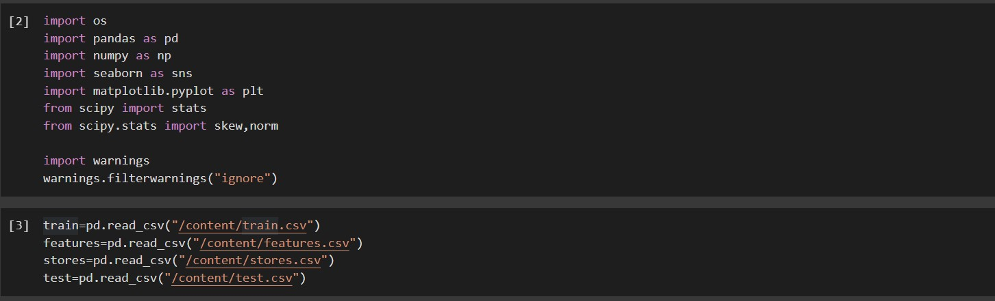
Implementation of Polynomial Regression Model:
PROBLEM STATEMENT:
There are many seasons that sales are significantly higher or lower than averages. If the company does not know about these seasons, it can lose too much money. Predicting future sales is one of the most crucial plans for a company. Sales forecasting gives an idea to the company for arranging stocks, calculating revenue, and deciding to make a new investment. Another advantage of knowing future sales is that achieving predetermined targets from the beginning of the seasons can have a positive effect on stock prices and investors' perceptions. Also, not reaching the projected target could significantly damage stock prices, conversely. And, it will be a big problem especially for Walmart as a big company

Slide 10
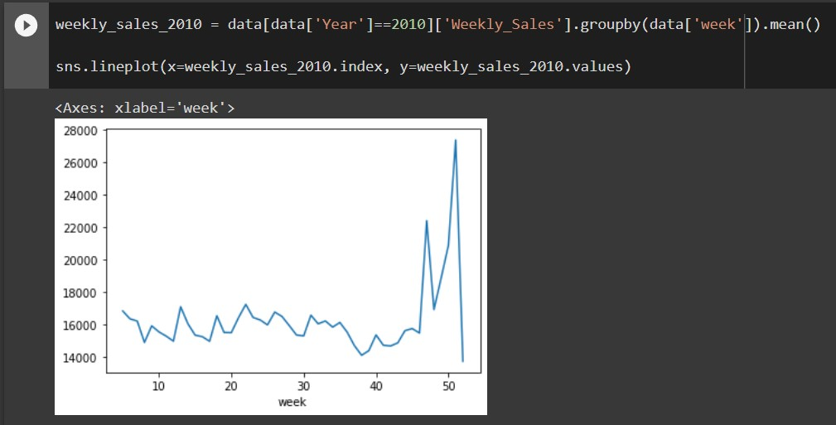
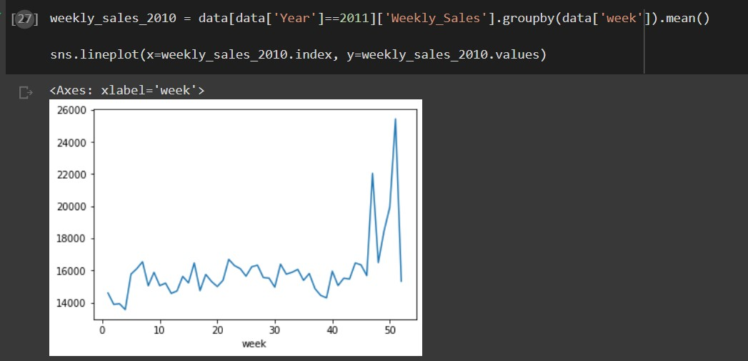
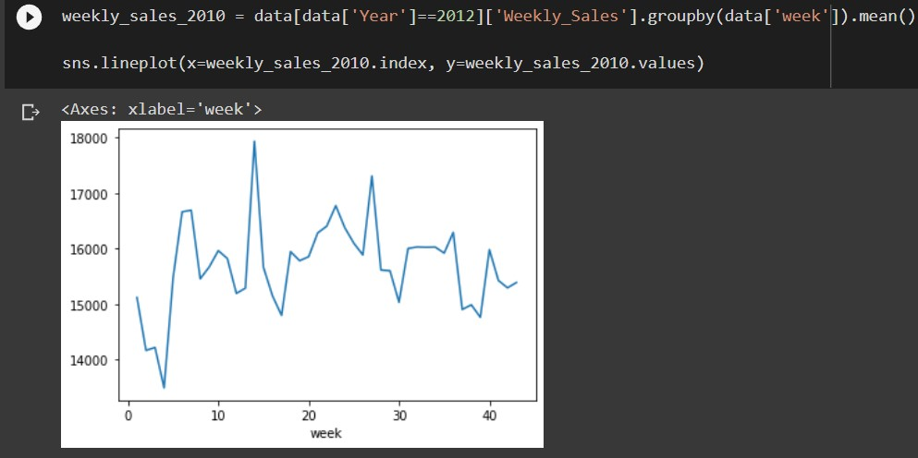
Plot for the weekly sales based on weeks for particular year

Slide 11
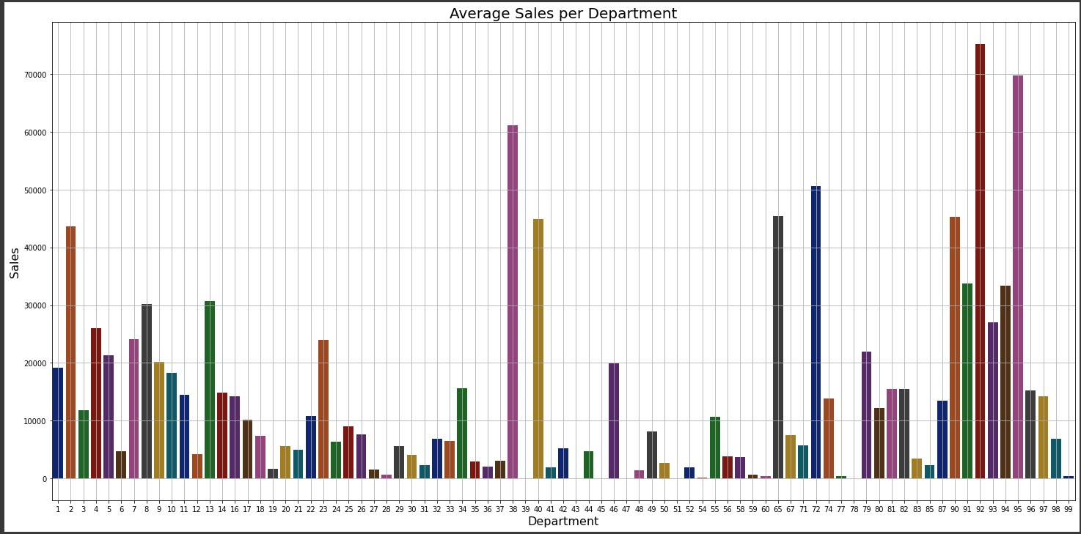

Slide 12
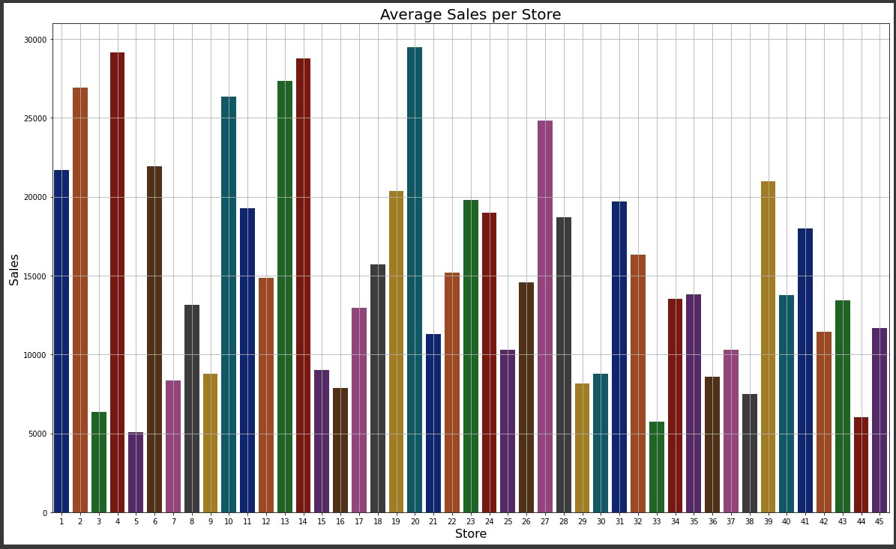

Slide 13
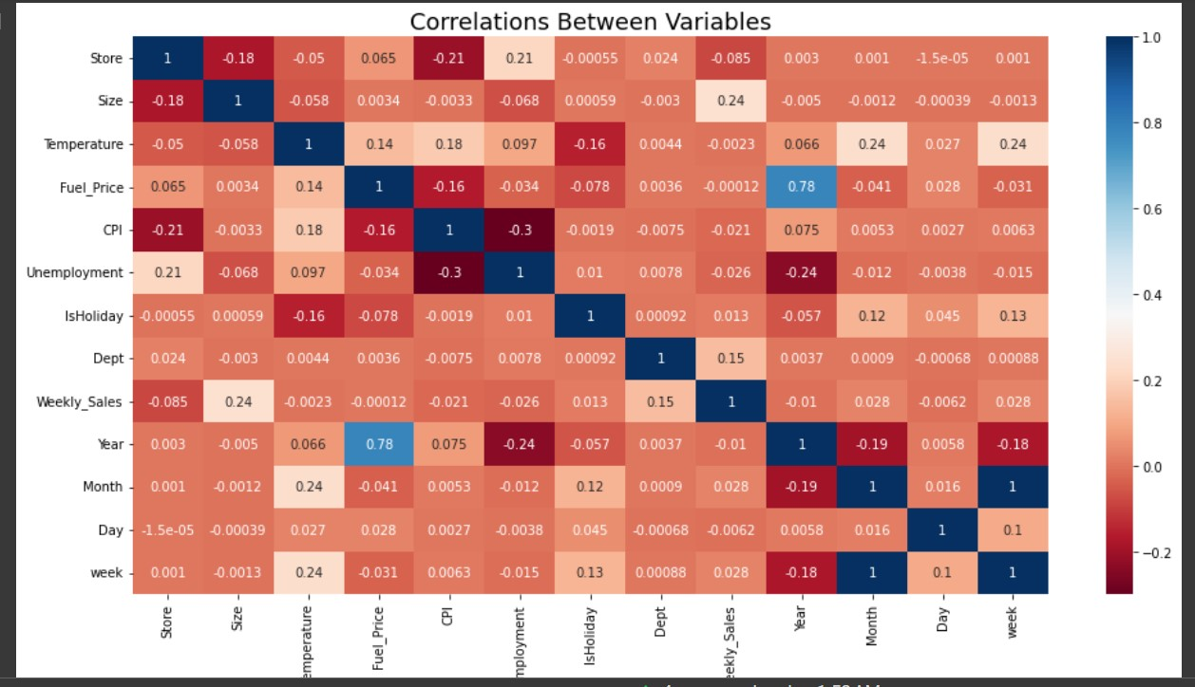
Plotting Heat Map in order to see Correlation between Variables, here the correlation between with the column is one which means highly correlated.
The region which is in red is said to be negative correlated and the region which is blue is positive correlation

Slide 14
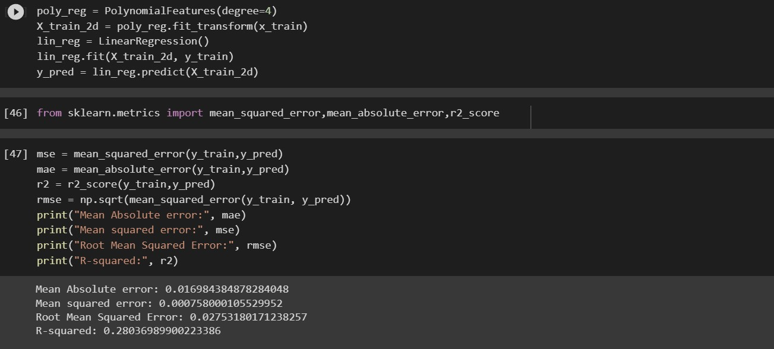

Slide 15
Conclusion
Mean Absolute Error: 0.016984384878284048
Mean Squared Error: 0.000758000105529952
Root Mean Squared Error: 0.02753180171238257
Mean Absolute Error (MAE) is a measure of how close the predicted values are to the actual values.
It is the average of the absolute differences between the predicted values and the actual values.
Mean Squared Error (MSE) is another measure of how close the predicted values are to the actual values.
It is the average of the squared differences between the predicted values and the actual values.
Root Mean Squared Error (RMSE) is the square root of the mean squared error. It is a commonly used measure
of the differences between predicted values and actual values.
These measures can be used to evaluate the performance of a machine learning model. A lower MAE, MSE, and RMSE indicate that the model is performing better.

Slide 16
References:
https://chat.openai.com/chat
https://www.kaggle.com/datasets/aslanahmedov/walmart-sales-forecast?select=features.csv
https://www.kaggle.com/datasets/aslanahmedov/walmart-sales-forecast?select=stores.csv
https://www.kaggle.com/datasets/aslanahmedov/walmart-sales-forecast?select=test.csv
https://www.kaggle.com/datasets/aslanahmedov/walmart-sales-forecast?select=train.csv

Slide 17
Thank You

